Slide 1
Klub Knoll Workshop, del 2
MicroPython/Python
Raspberry Pi Pico and Special Features

Slide 2
Agenda
Python / MicroPython
Syntax and elements in langauge
Control structure
Functions
Assignment
Links

Slide 3
IoT Program language ?

Slide 4
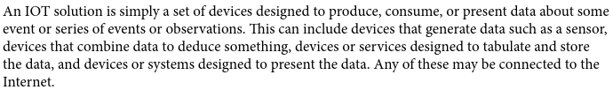
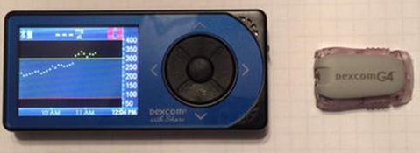
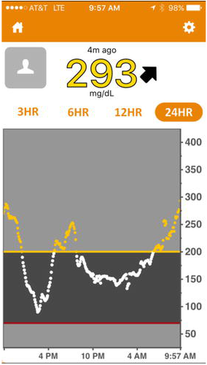
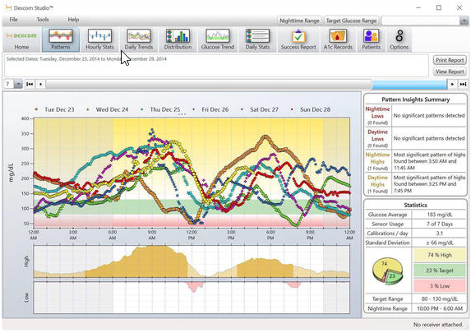
What is special when selecting prg language for IoT?
Dexcom Continuous Glucose Monitor with sensor
App for Dexcom CGM

Slide 5
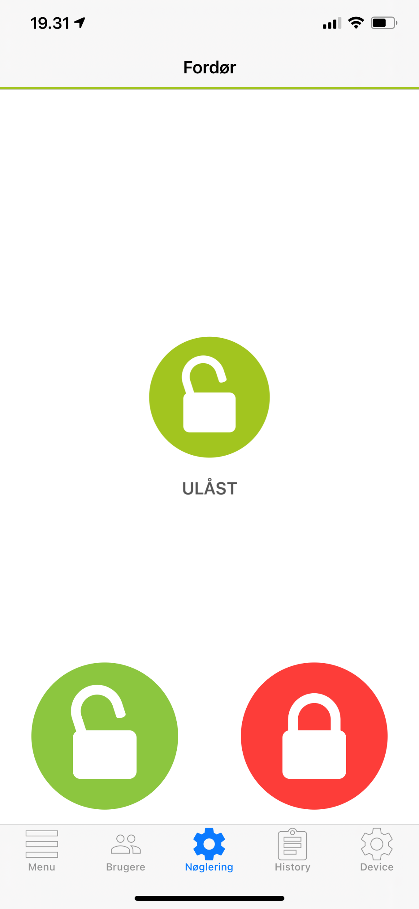
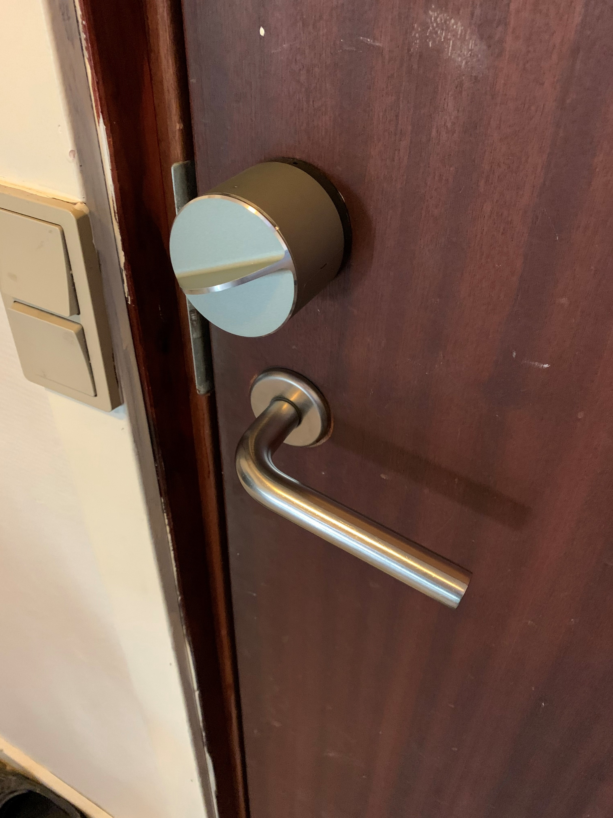
What is special when selecting prg language for IoT?
Some of the requirement for IoT end devices:
Limited power source (batterie)
Hard realtime
Cheap and small in size
Limited resources like memory, batterie, hardware components, no fpu, etc.
Security an issue (cost power and processing)

Slide 6
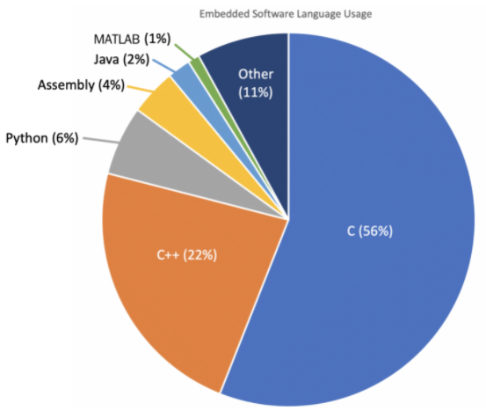
Python and IoT (Embedded systems)
The breakdown of programming languages used for embedded systems in 2019 is shown in the figure.
From 2017 to 2019 popularitet of Python has doubled
Source: https://www.embedded.com/

Slide 7
In Python it is (often)simple to make complex thing
import win32com.client as wincl
speak = wincl.Dispatch("SAPI.SpVoice")
f = open("text.txt")
text=f.readline()
textlist = text.split(sep=".")
for sentence in textlist:
speak.Speak(sentence)
“Simple is better than complex.”

Slide 8
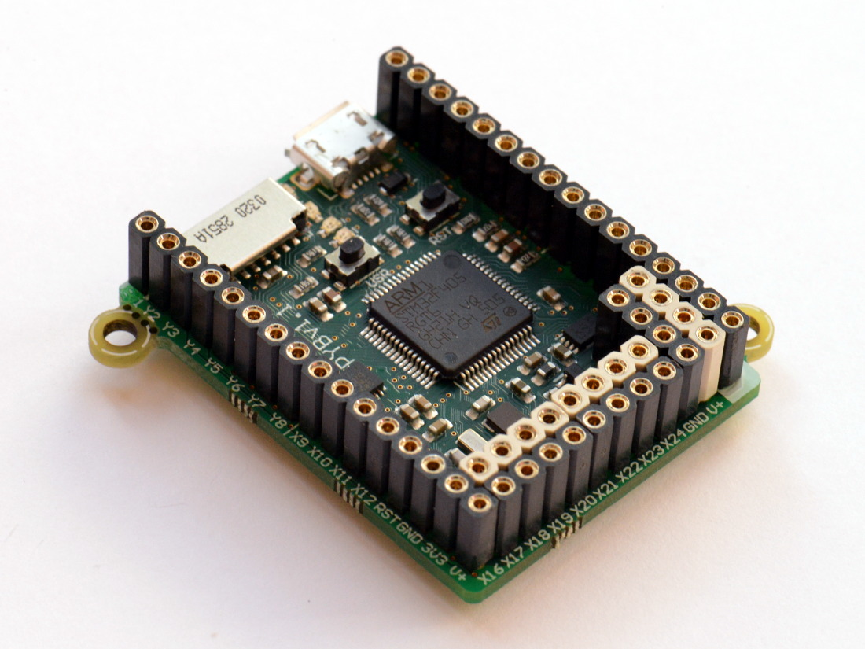
Micropython
MicroPython was originally created by the Australian programmer and physicist Damien George, after a Kickstarter backed campaign in 2013.
The original Kickstarter campaign released MicroPython with a pyboard microcontroller, MicroPython supports a number of ARM based architectures.
MicroPython has since been run on Arduino based products, ESP8266, ESP32, and other Internet of things hardware.

Slide 9
Python vs MicroPython
The language features of Python (3.5) are also available in MicroPython.
The biggest difference between Python and MicroPython is that MicroPython was designed to work under constrained conditions.
MicroPython does not come with the full standard library.
It only includes a small subset of the Python standard library.

Slide 10
Python standard libraries and micro-libraries
Name | Functionality
_thread | Low-level threading API
array | arrays of numeric data
builtins | builtin functions, constants, exceptions, and decorators
cmath | mathematical functions for complex numbers (ikke implementeret)
gc | control the garbage collector
math | mathematical functions
sys | system specific functions
ubinascii | binary/ASCII conversions
ucollections | collection and container types
uerrno | system error codes (ikke implementeret)

Slide 11
Python standard libraries and micro-libraries
Name | Functionality
uhashlib | hashing algorithm
uheapq | heap queue algorithm (ikke implementeret)
uio | input/output streams
ujson | JSON encoding and decoding
uos | basic “operating system” services
urandom | Random Number Generation
ure | regular expressions
ustruct | pack and unpack primitive data types
utime | time related functions

Slide 12
MicroPython-specific libraries
Name | Functionality
rp2 | Raspberry Pi Pico specific
machine | Raspberry Pi Pico module with some basic hardware functions.
onewire | Driver for onewire devices (ikke implementeret)
neopixel | Driver for neopixel (ikke implementeret)
dht | Driver for DHT devices (ikke implementert)

Slide 13
Goals of Python
Python is a high-level, interpreted, object-oriented scripting language.
One of the biggest goals of Python is to have a clear, easy-to-understand syntax that reads as close to English as possible.
That is, you should be able to read a Python script and understand it even if you haven't learned the language (! ☺).
Python also has less punctuation (special symbols) and fewer syntactical machinations than other languages.
MicroPython – Support of HW, run on constrain devices !.

Slide 14
Syntax and elements in langauge

Slide 15
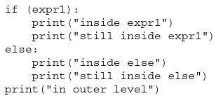
Code block
Python don’t use a code block demarcated with symbols ({ }, Begin end, ….) it uses indentation.
Important that you are using the same indentation !!!!
Don’t use ; after statement !!!!

Slide 16
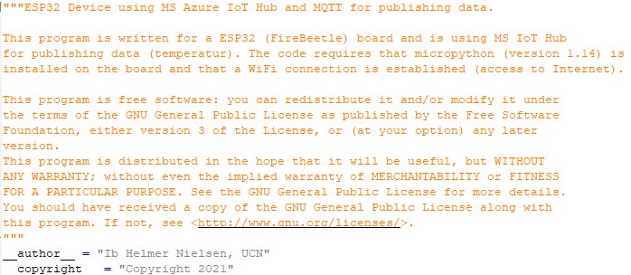
Comments
To add comments to your source code use #
Everything after # is regarde as a comment
Block comment is made by three double quotes and ends by three double quotes.

Slide 17
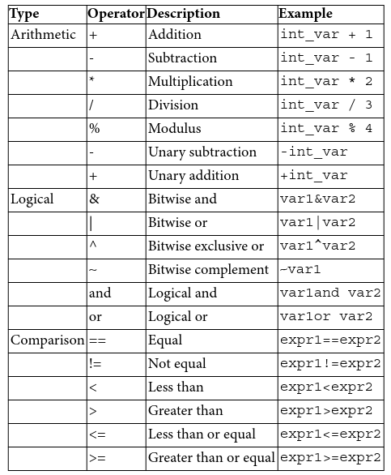
Arithmetic
No unary ++ or -- operator ☹

Slide 18
Variables
Python has no command for declaring a variable.
A variable is created the moment you first assign a value to it.
Variables do not need to be declared with any particular type, and can even change type after they have been set.
A variable name must start with a letter or the underscore character
A variable name cannot start with a number
A variable name can only contain alpha-numeric characters and underscores (A-z, 0-9, and _ )
Variable names are case-sensitive

Slide 19
Assignment and variable
Operator | Example | Same As
= | x = 5 | x = 5
+= | x += 3 | x = x + 3
-= | x -= 3 | x = x - 3
*= | x *= 3 | x = x * 3
/= | x /= 3 | x = x / 3
%= | x %= 3 | x = x % 3
//= | x //= 3 | x = x // 3
**= | x **= 3 | x = x ** 3
&= | x &= 3 | x = x & 3
|= | x |= 3 | x = x | 3
^= | x ^= 3 | x = x ^ 3
>>= | x >>= 3 | x = x >> 3
<<= | x <<= 3 | x = x << 3
Assignment operator see figur to the right
Multiple assignment is legal
pi = 3.1416
x, y, z = “UCN", “KEA", “UCC“
x, y, z = “UCN”

Slide 20
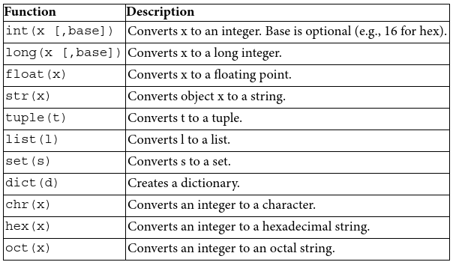
Variable type
Casting
If you want to specify the data type of a variable, this can be done with:
x = str(7) # x will be ‘7'
y = int(9) # y will be 9
z = float(13) # z will be 13.0
Get the Type
You can get the data type of a variable with the type() function.

Slide 21
Python If ... Elif
An "if statement" is written by using the if keyword.
a = 7
b = 9
if b > a:
print("b is greater than a")
The elif keyword is pythons way of saying "if the previous conditions were not true, then try this condition".
a = 42
b = 42
if b > a:
print("b is greater than a")
elif a == b:
print("a and b are equal")
“There should be one-- and preferably only one --obvious way to do it.”

Slide 22
Python If … Else
The else keyword catches anything which isn't caught by the preceding conditions.
a = 7
b = 9
if b > a:
print("b is greater than a")
elif a == b:
print("a and b are equal")
else:
print("a is greater than b")

Slide 23
Assignment #1 Reaction game
Make a simple reaction game that works like the description below:
Turn on one of the three LED (hint: use urandom) and measure the time (hint: use utime) before the user press the bottom under the LED that is turned on.
With print write out the reaction time in milli second.
(extra) Add also the option that it is the buzzer that turns on
(extra) Write out a warning if the user press bottom before a LED or the buzzer is turned on.

Slide 24
Basic Data Structure
 | Mutable | Immutable
Ordered (Indexed) | Lists | Tuples
Unordered | Frozensets | Sets
String in python is ordered sequence of letters. A string is immutable.
my_string = ”Hello World”
Dictionaries is a mapping data type that is unordered and mutable

Slide 25
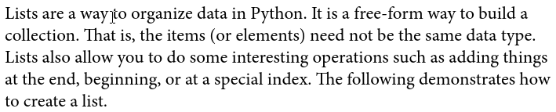
Python List
# List
my_list = [”Test”, 42, ”Hello World”, 24, 42]
my_list.append(”slut”)
my_list.insert(0,”start”)
count=my_list.count(42)

Slide 26
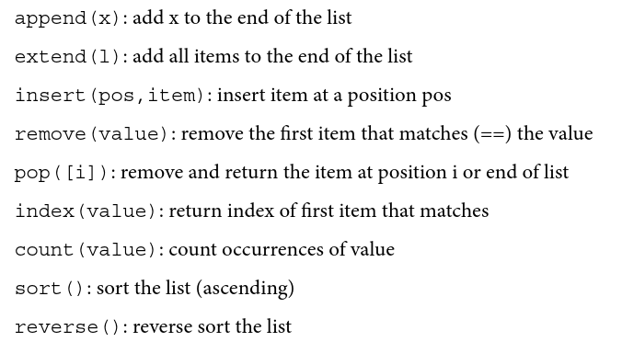
Python List

Slide 27
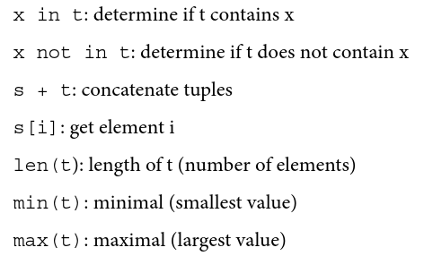
Python tubles
# Tuble
my_tuble = (7,9,13,”slut”)
# Print all elements in tuble
for element in my_tuble:
print(”{0}”.format(element)
# Test if value is in tuble
if 7 in my_tuble:
print(”yes 7 is in tuble”)

Slide 28
Python Set and dictionaries
# Set
my_set = {"apple", "banana", "cherry", "apple"}
# Dict
my_dict = {
“name”: “Ib Helmer Nielsen”,
“age”: 27,
}

Slide 29
Assignment #2 Reaction game for two players
Rewrite the reaction game from assignment #1 so that it is for two players.
Player 1 uses SW1, player 2 uses SW3 and the game is now over 10 rounds, and when LED D2 is turned on the player must press their bottom
Measure the average reaction time over 10 round for each player after round 10 show the result.

Slide 30
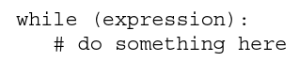
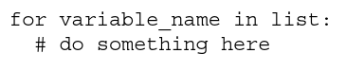
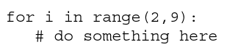
Python Loop
While
For

Slide 31
Python Functions
Python allows to use modularization of the code.
While python supports object-oriented programming by way of classes, it also can use the more fundamental level of break the code into smaller chunks using functions.
Creating a Function is defined using the def keyword
def my_function():
print("Hello from my function")
my_function() # Call to function

Slide 32
Python function, arguments and retrun values
def my_function(x):
return x+42
print(my_function(3)) # Call funtion
def recu(k):
if(k > 0):
result = k + recu(k - 1)
print(result)
else:
result = 0
return result
recu(6)

Slide 33
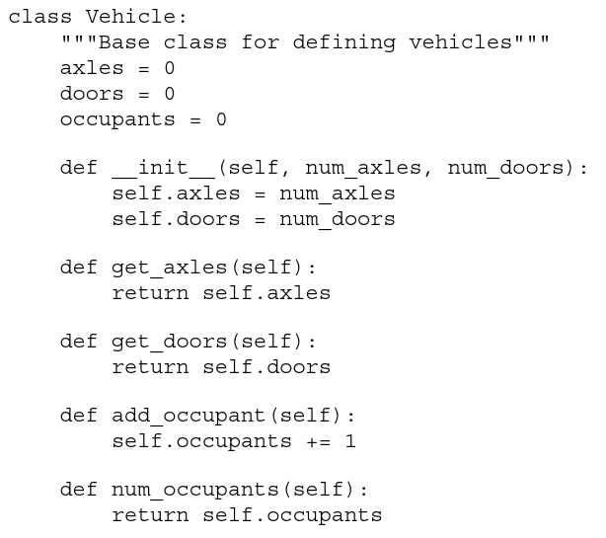
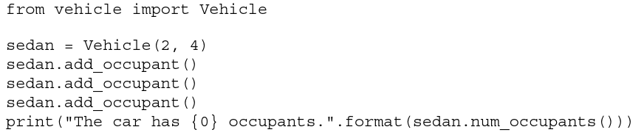
Python class

Slide 34
PIO
Programmable input/output block

Slide 35
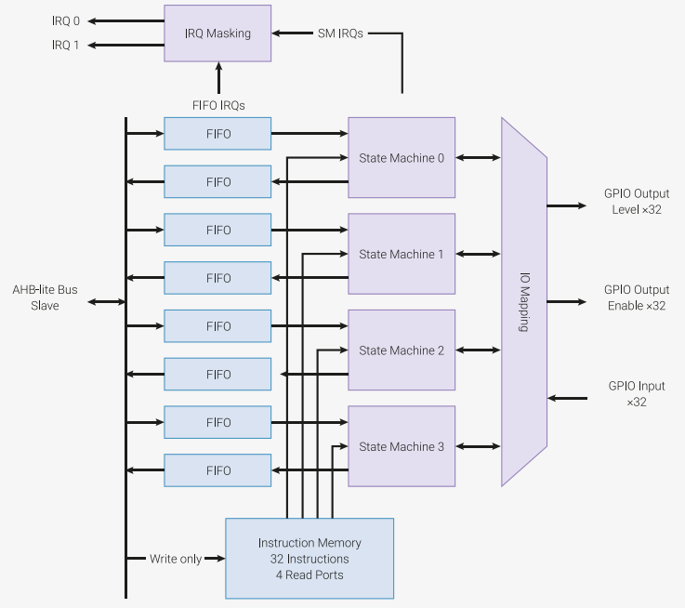
PIO

Slide 36
PIO
Each state machine is equipped with:
Two 32-bit shift registers – either direction, any shift count
Two 32-bit scratch registers
4×32-bit bus FIFO in each direction (TX/RX), reconfigurable as 8×32 in a single direction
Fractional clock divider (16 integer, 8 fractional bits)
Flexible GPIO mapping
DMA interface, sustained throughput up to 1 word per clock from system DMA
IRQ flag set/clear/status

Slide 37
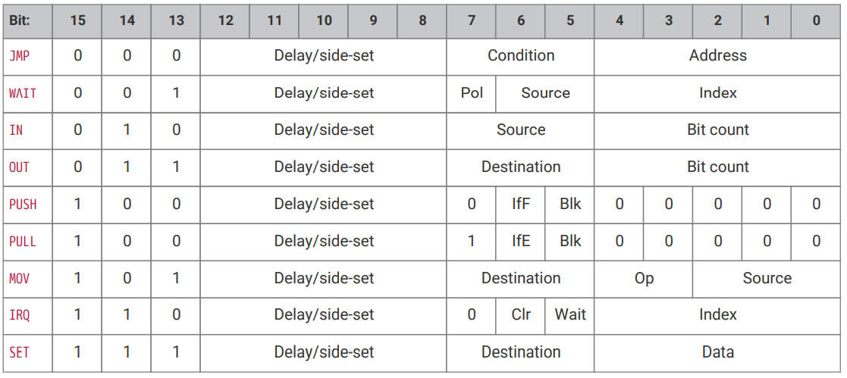
Instructionset

Slide 38
PIO example (Blink LED with 1Hz)
import time
from machine import Pin
import rp2
@rp2.asm_pio(set_init=rp2.PIO.OUT_LOW)
def blink_1hz():
# Cycles: 1 + 1 + 6 + 32 * (30 + 1) = 1000
irq(rel(0))
set(pins, 1)
set(x, 31) [5]
label("delay_high")
nop() [29]
jmp(x_dec, "delay_high")
# Cycles: 1 + 7 + 32 * (30 + 1) = 1000
set(pins, 0)
set(x, 31) [6]
label("delay_low")
nop() [29]
jmp(x_dec, "delay_low")

Slide 39
PIO exampel (Blink LED with 1Hz)
# Create the StateMachine with the blink_1hz program, outputting on Pin(25).
sm = rp2.StateMachine(0, blink_1hz, freq=2000, set_base=Pin(25))
# Set the IRQ handler to print the millisecond timestamp.
sm.irq(lambda p: print(time.ticks_ms()))
# Start the StateMachine.
sm.active(1)

Slide 40
Links

Slide 41
Relevant Links
https://docs.micropython.org/en/latest/
https://www.raspberrypi.org/products/raspberry-pi-pico/specifications/
https://www.raspberrypi.org/forums/index.php
https://www.w3schools.com/python/
https://www.python.org/

Slide 42
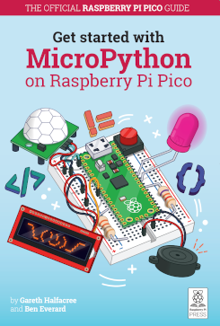
Book

Slide 43
Port Assignment
Item | Port on RPiP | Jumper
led1 | GPIO10 | -
led2 | GPIO11 | -
led3 | GPIO12 | -
sw1 | GPIO13 | -
sw2 | GPIO14 | -
sw3 | GPIO15 | -
Reset | RUN | -
Buzzer | GPIO9 | JP1
Analog#0 | GPIO26/ADC0 | JP5
Analog#1 | GPIO27/ADC1 | JP6
Analog#2 | GPIO28/ADC3 | JP7
SD-DAT0 | GPIO19 | -
SD-DAT1 | GPIO20 | JP3
SD-DAT2 | GPIO21 | JP2
SD-DAT3/CD | GPIO22 | -
SD-CMD | GPIO18 | -
SD-CLK | GPIO5 | JP4

Slide 44
Filer i MicroPython

Slide 45
Filer i MicroPython
Der er på RP2 implementer filsystem og fra microPython kan dette anvendes.
Åben fil for skrivning:
myfile = open("temps.txt","w")
Åbenfil for læsning:
myfile = open("temps.txt","w")
Skriv til fil : myfile.write(whateverdata)
Læs fra fil : x=myfile.read()

Slide 46
Filer i MicroPython
Der findes i biblioteket os en del funktioner til at håndtere filsystemet:
Navn | Funktion | Navn | Funktion
uname |  | rename | Rename a file
chdir | Change current directory | rmdir | Remove a directory
getcwd | Get the current directory | stat | Get the status of a file or directory
listdir | List the current directory | statvfs | Get the status of a fileystem
mkdir | Create a new directory | ilistdir | This function returns an iterator which then yields tuples corresponding to the entries in the directory that it is listing
remove | Remove a file | mount | Mount the filesystem object fsobj at the location in the VFS given by the mount_point string
 |  | umount | Unmount a filesystem.

